Slide 1
Using Bayesian Optimization in Pose Graphs Based SLAM 28th July
Zuxun Wang

Slide 2
Progress Since Last Meeting
Compute the CNEES value for cw2 SLAM system (miniSLAM).
Only enable the odemetry and GPS.
Add new function to compute the dimensions of X and Z.

Slide 3
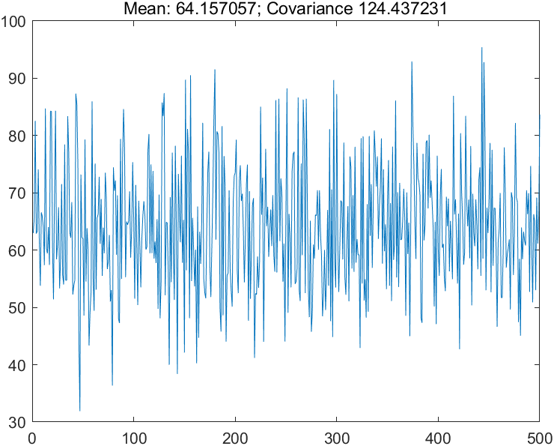
Chi2 values for miniSLAM
Number of episodes: 500
scenarioDirectory: 'q1_e'
configuration.enableGPS = true
dimX: 972
dimZ: 1033
N: 61

Slide 4
Problems / Issues
Currently, I only generate BayesOpt results for GPS systems.
Do I need to test BayesOpt for Linear systems to learn Q and R values ? Or is it too simple, we don’t need to do that?

Slide 5
Problems / Issues
When I was writing the report, I found the `Related Work` part can be difficult as I cannot find literatures that doing things similar to what I’m doing right now.
When I searching for pose graph tuning or optimisation, the results were things related using other optimisation methods for pose graph, methods other than Gauss-Newton and Levenberg-Marquardt.
I found an example report on UCL Moodle, `Semantic SLAM with Public PriorInformation`, which does not include the Related Work part, as there is no prior information for the author to refer to.
I’m wondering if you could suggest me some searching keywords for me to search, or I could continue my report without Related Work part.

Slide 6
Planned Activities
For miniSLAM
Generate the scaled colour plots.
Surf plots for C values.
BayesOpt to learn omega scale factors (or Q and R).

